Slide 1
Legislative Update
NGAUS Legislative Staff

Slide 2
Agenda
Mission
Organizational Structure
Legislative Team
Strategic Overview
Resolutions
Notable FY21 Accomplishments
Priorities for a 21st Century National Guard
Congressional Cycle Overview

Slide 3
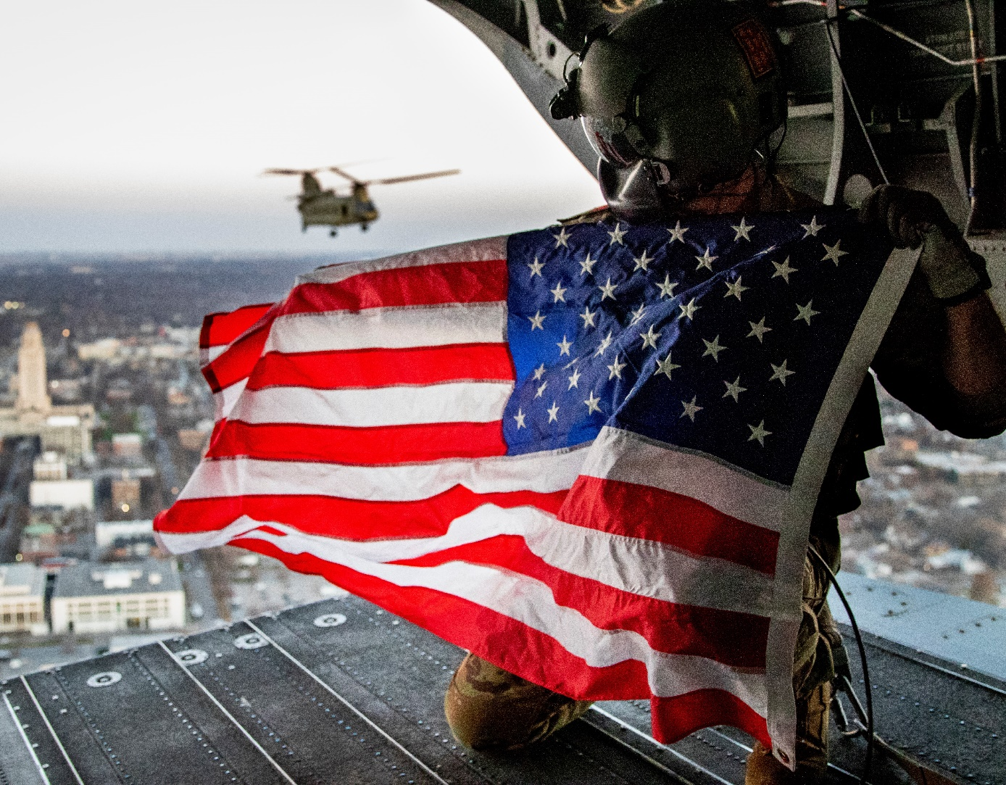
Mission
Serve as a strong advocate for National Guard service members, their families, and veterans in Washington, D.C.
Continuously improve National Guard readiness, modernization, and quality of life within the Total Force
Preserve and promote the National Guard’s rich militia heritage as the first military organization of the U.S.

Slide 4
Organizational Structure
Board of Directors
NGAUS President
Chief of Staff
Executive Staff
Legislation
Communications
Membership & Marketing
Industry Relations
Contracts/Finance/HR
Vice President
Director
Director
Director
Director
Legislative Staff
Communications Staff
Membership Staff
Industry Relations Staff
Finance Staff

Slide 5
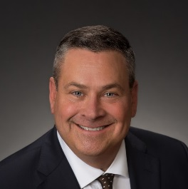
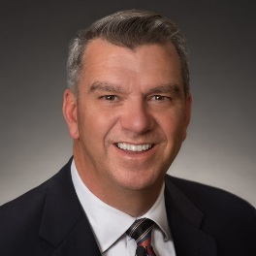
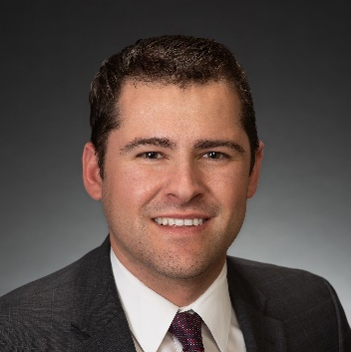
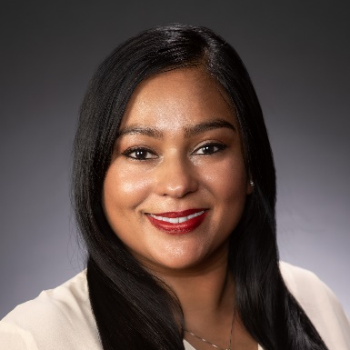
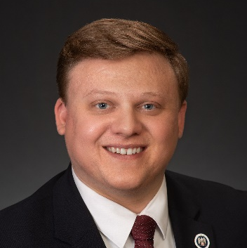
Legislative Team
BG (Ret) Roy Robinson
NGAUS President
COL (Ret) Mike Hadley
Vice President, Government Affairs
JC Cardinale
Legislative Affairs Manager
Joint & Personnel Programs
Priya Ghosh Ahola
Legislative Affairs Manager
Air National Guard Programs
Marcy Weldin
Legislative Affairs Manager
Army National Guard Programs
Blaise Lemke
Legislative Analyst

Slide 6
Strategic Overview
Advocacy
Apolitical & Non-Partisan
Collaboration with:
DoD, NGB, VA and DHS
Military Service Organizations, Veteran Service Organizations
Lobby for National Guard equipment parity and benefits equity
Develop strong relationships with Congress and staff
Grassroots engagement

Slide 7
Resolutions Process
Dec.
States Draft
Jun.-July
NGAUS Review
July*
NGAUS BoD Review
Aug./Sep.
NGAUS Conf. Consideration
Oct.-Nov.
Prioritization/ Leg. Action Plan
Jan.-May
States Approve
Aug.
NGAUS Preps Drafts
*All Drafts Due to
NGAUS by July 31

Slide 8
Notable FY21 Accomplishments
Army
$100.0M for ARNG High Mobility Multi-purpose Wheeled Vehicle (HMMWV) modernization program
$884.4M for Joint Light Tactical Vehicles (JLTVs) for the Army
$862.0M for UH-60 Black Hawk M model helicopters for the Army
Air
$570.0M for 6 C-130J Super Hercules aircraft for ANG
$265.5M for C-130H modernization, includes:
- $180.0M for NP2000 propeller upgrades
- $79.0M for T-56 Series 3.5 engine modifications
$75.0M for F-16 Viper Active Electronically Scanned Array (AESA) radars for ANG
Joint/Personnel
Allows CNGB to provide annual unfunded priorities list to Congress
Three-month maternity leave including retirement credit and pay for traditional Soldiers and Airmen
Access to VA home loans for Guardsmen who have served on Title 32 orders
Expanded USERRA protections to Guardsmen serving on SAD orders, or responding to a National or Federal Natural Disaster Emergency
$950.0M for the National Guard and Reserve Equipment Account (NGREA), includes:
- $285.0M for both ARNG and ANG
$7.0 M for the National Guard preventative mental health program

Slide 9
Priorities for a 21st Century National Guard Ensuring Deployability, Sustainability, and Interoperability with the Active Component through…
The Same Organization
Future Multi-Domain Battlefield Interoperability, including:
– Deployable & Interoperable Force Structure that is Validated & Doctrinally Consistent
– Space National Guard as Primary Combat Reserve within Space Force
– Continued National Guard Integration into Total Force Cyber Mission & Training
The Same Equipment
Deployable, Interoperable & Sustainable Equipment
Concurrent & Proportional Fielding of Equipment to the National Guard, including:
– UH-60M, F-35A, KC-46A & C-130J Procurement
National Guard Equipment Modernization & Recapitalization, including:
– HMMWV, M1 & M2, C-130H, A-10, F-15 & F-16 Modernization
The Same Resources and Benefits
Zero Cost TRICARE to Ensure Reserve Component Medical Readiness
Post 9/11 GI Bill Parity
Robust National Guard & Reserve Equipment Account (NGREA) Funding
Tax Incentives for Guardsmen & Employers
Ready Access to Mental Health Care & Suicide Prevention
Increased National Guard Military Construction (MILCON) Funding

Slide 10
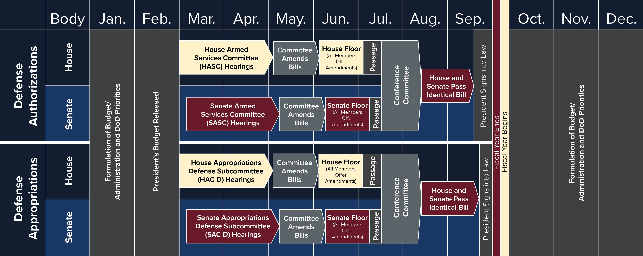
Defense Congressional Cycle
CURRENT ACTIVITY
CURRENT
ACTIVITY

Slide 11
Legislative Update
Authorizations
S.1605 – National Defense Authorization Act for Fiscal Year 2022
President signed into law on 27 December 2021
Authorizes $950.0M total NGREA
Authorizes all unfunded priorities requested by the Chief, National Guard Bureau
Appropriations
H.R.4432 - Department of Defense Appropriations Bill, 2022
$950M total NGREA; $285M for the ARNG, $285M for the ANG
Introduced in the House on 15 July
Next Step: Considered by the full House
H.R.4432 - Department of Defense Appropriations Bill, 2022
$1.45B total NGREA; $435M for the ARNG, $435M for the ANG
Introduced in the Senate on 20 October
Next Step: Considered by the full Senate
H.R.6119 – Continuing Resolution
Provides stopgap funding for the Federal Government until 18 February 2022

Slide 12
Legislative Update
H.R.3512 – Healthcare for our Troops Act
Provides Zero-Cost TRICARE Reserve Select and dental coverage for all members of the RC
Authorizes TRS eligibility for RC servicemembers who are federal employees in their civilian capacity
H.R.1836 – Guard and Reserve GI Bill Parity Act
Provides GI Bill education benefits parity between the Active and Reserve Components
S.1297 – Record of Military Service for Members of the Armed Forces Act of 2021
Provides definitive record of service (DD-214) for members of the RC for titles 14 and 32
Standardizes proof of service across all compos making it easier for Guardsmen to receive benefits
S.1859/H.R.3626 – Reserve Component bonus and incentive pay
Ensures bonus and incentive pay parity between AC and RC servicemembers
S.3215 – USACE Military Personnel Augmentation Act of 2021
Expands USACE eligibility to all Warrant Officers and Enlisted members

Slide 13
Legislative Outreach Programs
Next Summit: July 17-20, 2022
Targeted towards Company Grade and Warrant Officers from the 54
Goals:
Elevate CGOs view from the State to the National level highlighting challenges faced across the 54.
Increase CGO involvement and advocacy at the grassroots level
Short Video:
https://www.youtube.com/watch?v=h8Xmn1nUvZE
Next Workshop: February 10th, 2022
Targeted towards CACOs, Executive Directors and Presidents of the 54 Associations
Goal:
Inform audience of NGAUS Legislative Priorities and efforts syncing messaging across the 54.

Slide 14
What Can You Do?
Get Informed
Communicate & Socialize
State & District Congressional Staff Outreach

Slide 15
Questions?

Slide 16
NGAUS Write to Congress H.R.3512 – Health Care for our Troops Act

Slide 17
117th Congress, First Session Overview
House of Representatives - 221-211 Democratic Majority
Senate - 50-50 split, Democratic control under 2021 US Senate Power-Sharing Agreement
President’s Budget released May 28, 2021
New Chairs in SASC, HASC, SAC-D, HAC-D, SVAC, HVAC
Committee | Senate Chair | Senate Co-Chair/Ranking Member | House Chair | House Ranking Member
Armed Services | Jack Reed (D-RI) | Jim Inhofe (R-OK) | Adam Smith (D-WA) | Mike Rogers (R-AL)*
Appropriations | Patrick Leahy (D-VT) | Richard Shelby (R-AL) | Rosa DeLauro (D-CT)* | Kay Granger (R-TX)
Defense Subcommittee | Jon Tester (D-MT)* | Richard Shelby (R-AL) | Betty McCollum (D-MN)* | Ken Calvert (R-CA)
VA/MILCON Subcommittee | Martin Heinrich (D-NM)* | John Boozman (R-AR) | Debbie Wasserman Schultz (D-FL) | John Carter (R-TX)
Veterans’ Affairs | John Tester (D-MT) | Jerry Moran (R-KS)* | Mark Takano (D-CA) | Mike Bost (R-IL)*

