Slide 1
Social Media
Bob Sweeney
Executive Director
National Guard Association of Washington

Slide 2
Why is Social Media Important?
Using Social Media correctly gives you the chance to promote your association – “tout your successes”
Immediate impact vs. the monthly/quarterly newsletter
Membership engagement - your members are online
Corporate Partners - highlight/connect with current partners (acknowledge-thank them for their support
Find and engage influencers - (State & Federal Legislators)

Slide 3
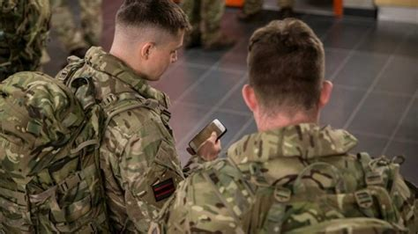
Everyone has a phone

Slide 4
Top Ten Social Media Platforms
Facebook – 2 billion users
YouTube – 2 billion users
WhatsApp – 2 billion users
Instagram – 1.16 billion users
TikTok – 689 million users
Snapshot – 433 million users
Reddit – 430 million users
Pinterest – 416 million users
Twitter – 353 million users
LinkedIn – 310 million users

Slide 5
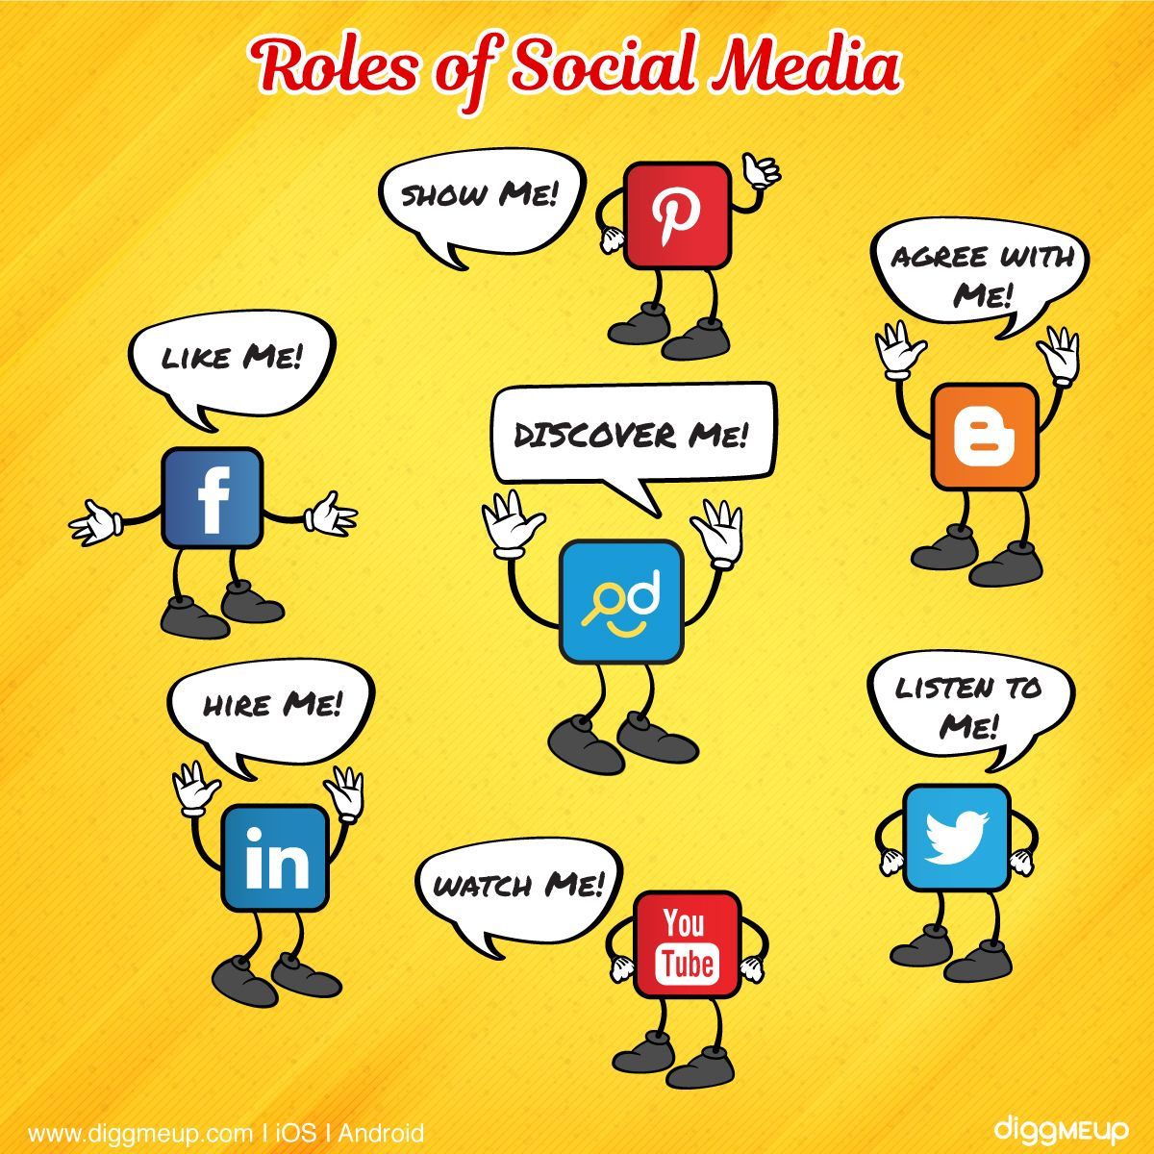
What are the roles of Social Media Platforms?

Slide 6
What does NGAW Do?
NGAW is on 3 platforms
Facebook
Twitter
LinkedIn

Slide 7
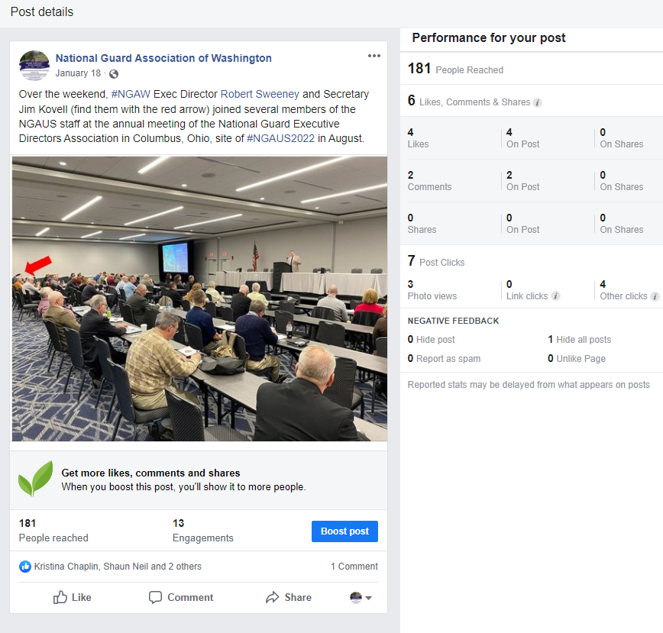
NGEDA Conference

Slide 8
NGAW - Facebook
Primary platform for connecting with our members
1,024 people like us
1,144 people follow us
Last 30 days
Reached 2,325
221 post engagements
6 page likes

Slide 9
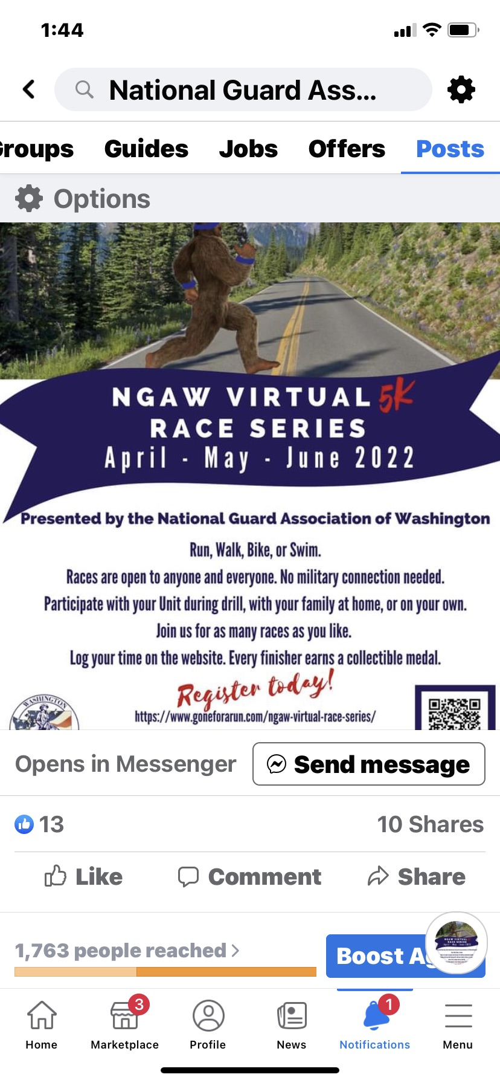
NGAW Facebook Posting

Slide 10
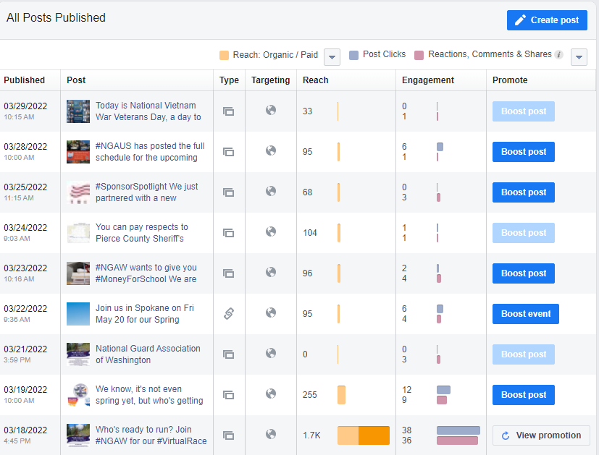
Facebook Analytics

Slide 11
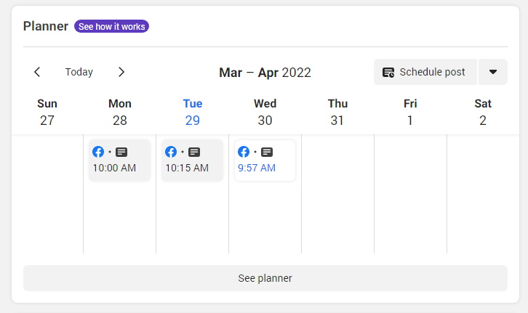
Facebook Posting Management - Events

Slide 12
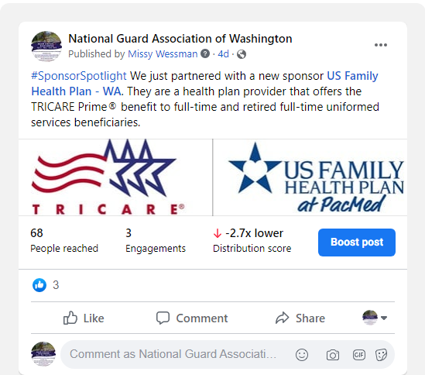
Corporate Sponsor Highlight

Slide 13
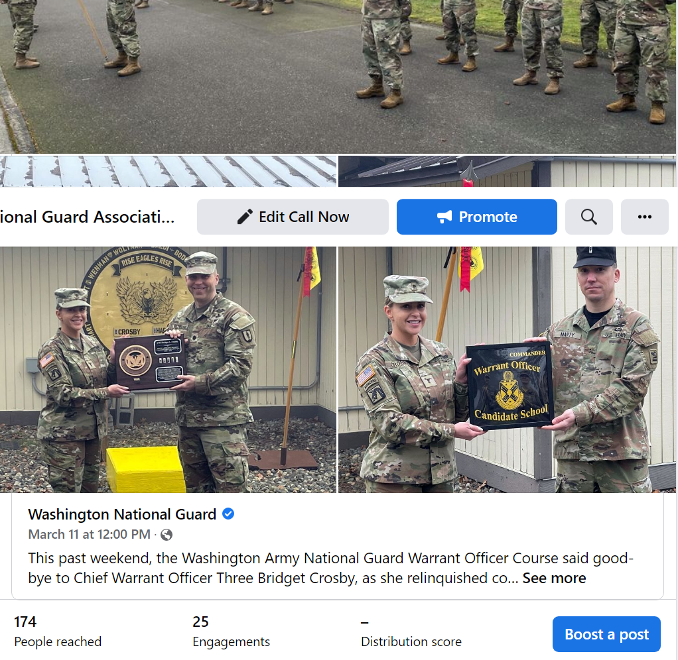
NGAW Facebook – Member Highlight

Slide 14
NGAW Facebook – NGAUS Conference ($180)

Slide 15
NGAW Twitter
Primary platform for connecting with elected State & Federal Legislators
452 following
561 followers
Can link Facebook to Twitter

Slide 16
NGAW Twitter – Legislative Outreach

Slide 17
NGAW LinkedIn – Switched to a business page/profile in January 2022

Slide 18
LinkedIn Analytics

Slide 19
Tips for Social Media Management
Find your Channel – what’s best for you?
Quality vs. Quantity
Always guiding them to your website
Answer posted questions
Plan posts & events
Use scheduling tools
Analyze Social Media Metrics
Highlight members
Highlight partners
Include your event hashtag and links to your social media profiles in emails.

Slide 20
Questions and comments

