Slide 1
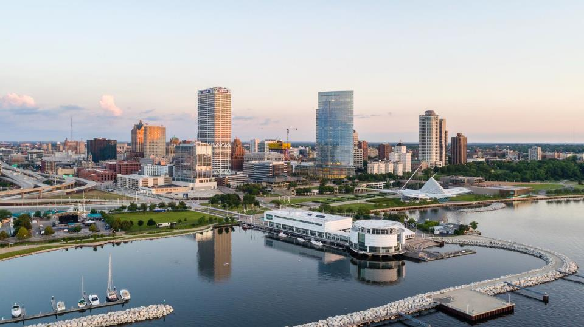
AUGUST 22-25, 2025
Your home – Milwaukee!

Slide 2
OVERVIEW OF EVENTS
THURSDAY
Travel Day
Exhibitors Golf Outing
FRIDAY
Travel Day
Delegate Golf Outing
Lake Michigan Sport Fishing
Bublr Bike Outing (Tentative)
Harley Davidson Motorcycle Ride
TAG Reception
CGO/WO Mixers
SATURDAY
Opening Ceremony
Fun Run
Business Sessions
Exhibits Open
Governor’s Reception
SUNDAY
Exhibits Open
Retiree Luncheon
Spouses Luncheon
Business Sessions
Hospitality Night
MONDAY
Exhibits Open
Business Sessions
TAG Spouses’ Luncheon
All States Dinner
TUESDAY
Travel Day

Slide 3
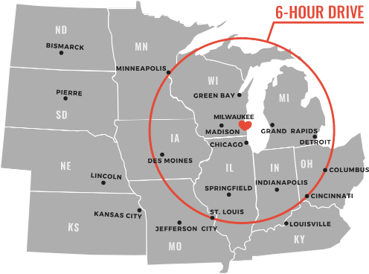
DRIVING HERE
Distance to Milwaukee (miles)
Madison, WI 80
Chicago, IL 90
Green Bay, WI 120 Grand Rapids, MI 280 Indianapolis, IN 280
Minneapolis, MN 335
Des Moines, IA 375
Detroit, MI 375
Cincinnati, OH 390
St. Louis, MO 390
Louisville, KY 390
Columbus, OH 450
Omaha, NE 510

Slide 4
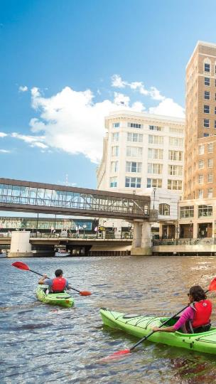
MILWAUKEE WEATHER
Known as The City of Festivals, Milwaukee is proud of its seemingly- endless ethnic and music festivals, miles and miles of beautiful beaches, and an array of summertime activities.
Average Monthly High and Low Temps
JAN | FEB | MAR | APR | MAY | JUN | JUL | AUG | SEP | OCT | NOV | DEC
29 | 33 | 42 | 54 | 65 | 75 | 80 | 79 | 71 | 59 | 46 | 33
16 | 19 | 28 | 37 | 47 | 57 | 64 | 63 | 55 | 43 | 32 | 20

Slide 5
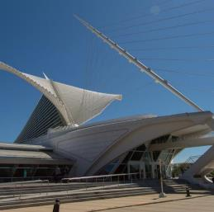
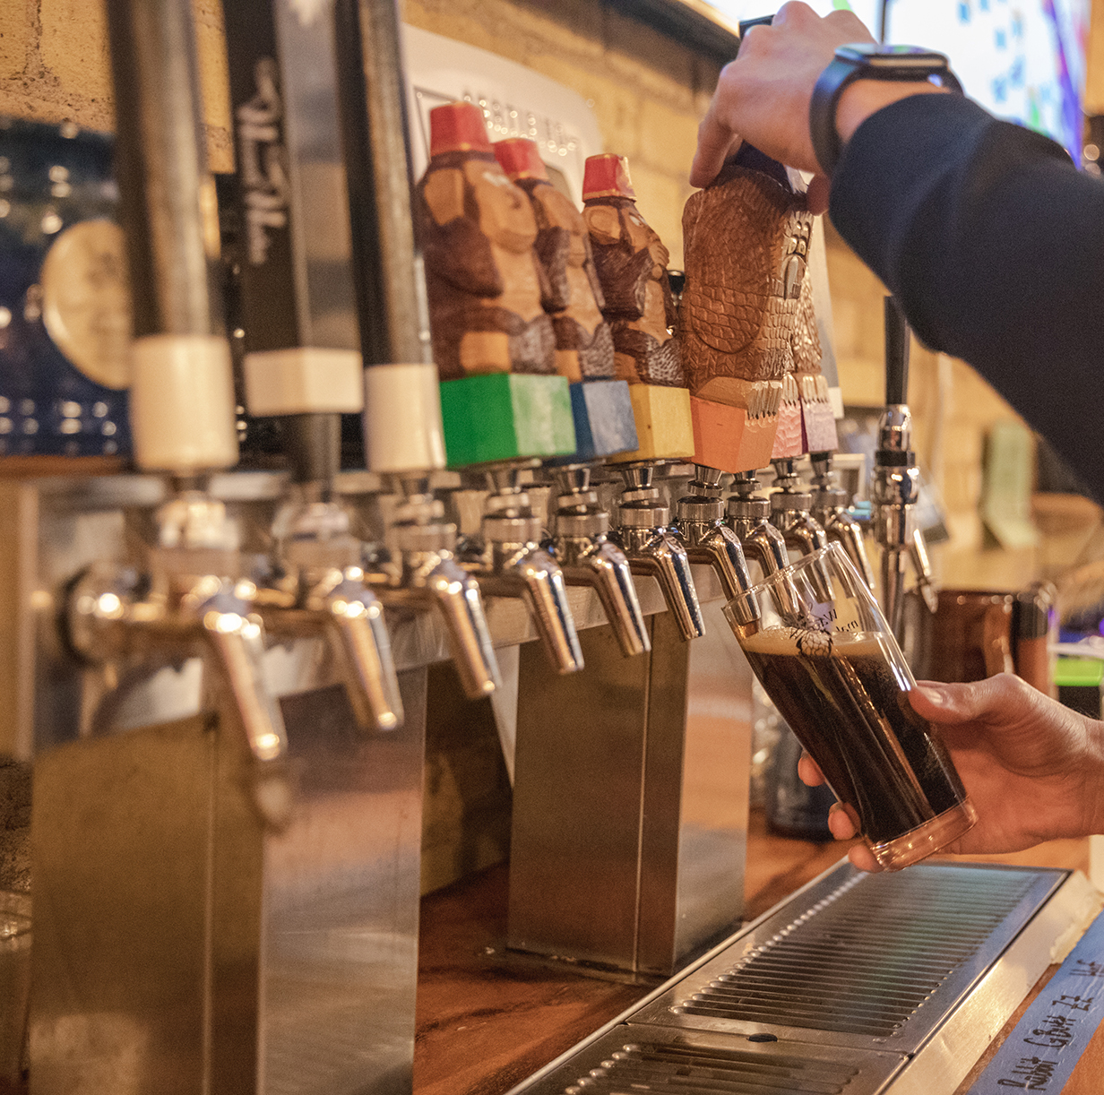
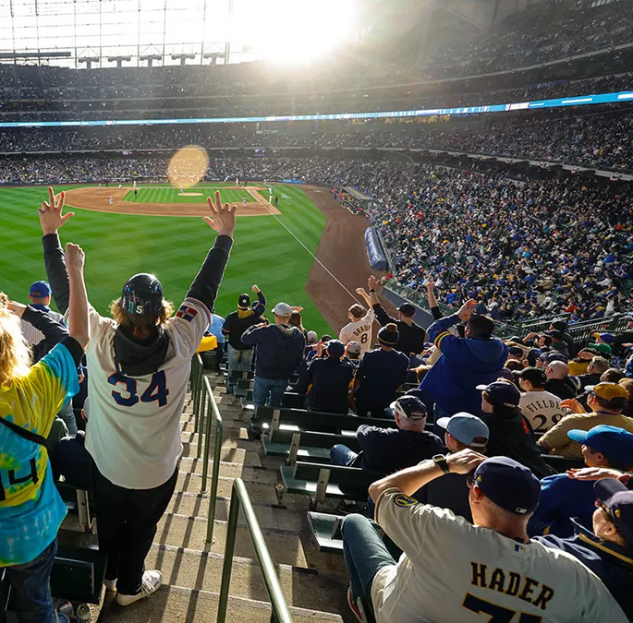
THINGS TO DO
Harley-Davidson Museum
Discovery World
Milwaukee Riverwalk
Brewery Tours
Milwaukee Public Museum
Boat Tours
Museum Mile
Mitchell Park Domes
Boerner Botanical Gardens
Lakeshore State Park
Lake Michigan Sport Fishing
Milwaukee County Zoo
Potawatomi Casino
Brewers Baseball

Slide 6
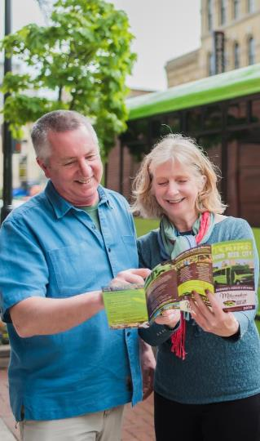
SPOUSE ACTIVITIES
Shopping
Dining
Tours & Museums
Boutique Shopping in the Third Ward
Antiques and Art on Brady Street
Food and Wine at the Public Market
Specialty Retail in Cedarburg
Malls in Wauwatosa
Café Benelux
Buckley’s
Bella Italiana
Harbor House
Mader’s
Onesto
Public Market
Smoke Shack
Milwaukee Art Museum
Pabst Mansion
Milwaukee Food and City Tours
Milwaukee Public Market
Riverwalk Boat Tours
Fiserv Forum Tour

Slide 7
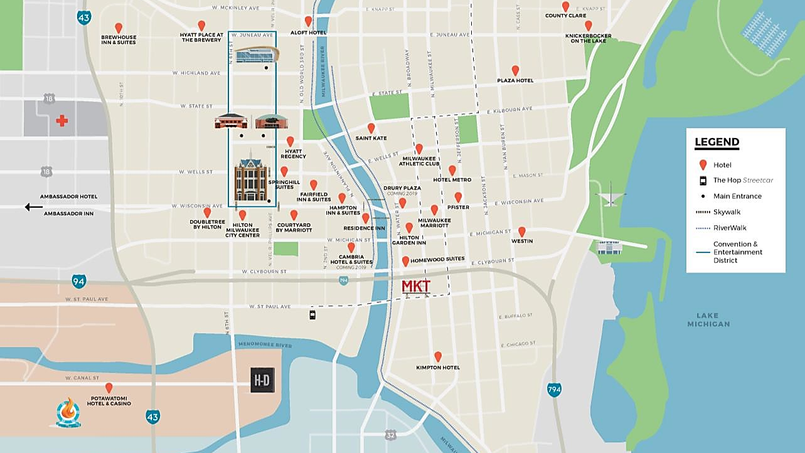
DOWNTOWN HOTEL MAP
Hyatt Regency
NGAUS HQ hotel
THE TRADE HOTEL
ALL HOTELS WITHIN
1 MILE OF BAIRD CENTER

Slide 8
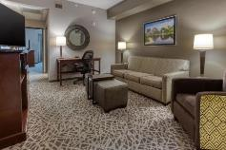
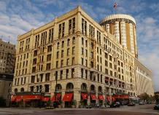
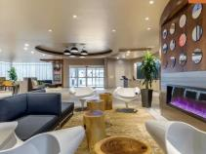
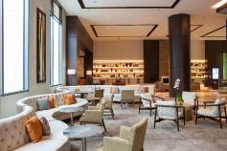
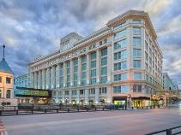
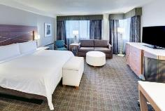
HOTEL AVAILABILITY
Over 2,400 committed rooms Downtown, and 50 hospitality suites
Drury Plaza Hotel Downtown
The Pfister Hotel
Cambria Hotel Downtown
Westin Hotel Downtown
Residence Inn by
Marriott Milwaukee Downtown
DoubleTree by Hilton
Milwaukee Downtown

Slide 9
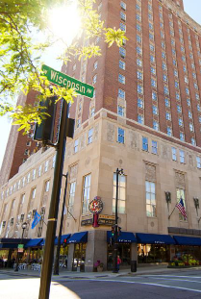
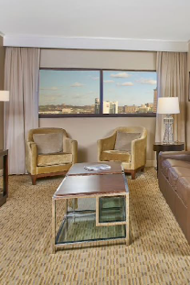
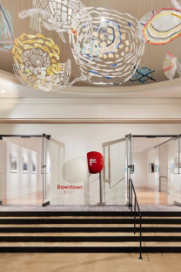
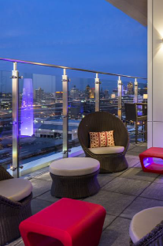
HOSPITALITY SUITES
Hilton Milwaukee
Hyatt Regency
Saint Kate the Arts Hotel
Potawatomi Hotel & Casino

Slide 10
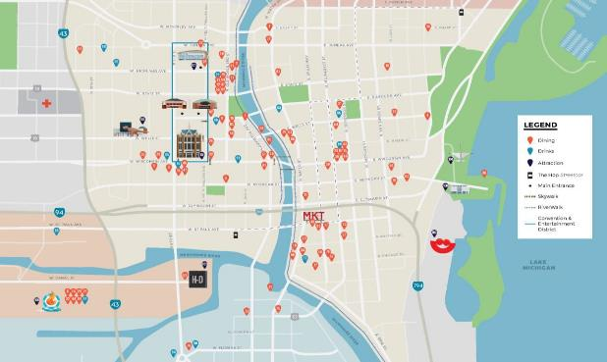
DOWNTOWN DINING MAP

Slide 11
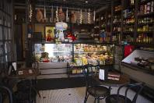
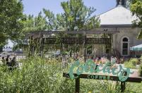
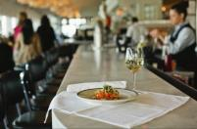
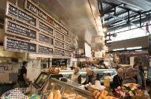
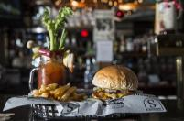
OVER 150 DOWNTOWN RESTAURANTS
Mader’s
Onesto
Gouda’s Italian Deli
Colectivo Coffee
Harbor House
Milwaukee Public Market
Sobelman’s Pub and Grill
Xankia Vietnamese

Slide 12
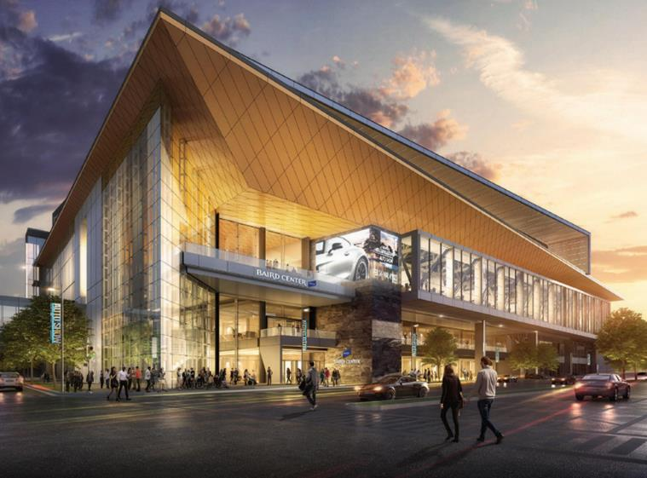
WISCONSIN CENTER DISTRICT
WCD: Baird Center
Designed with meeting planners
Nearly 300,000 square feet
189,000 square feet of exhibit space
$460-million expansion in 2023
Versatility, functionality, and style
State-of-the-art technology
One-way loading dock traffic
Almost two blocks of covered curb
400+ indoor parking spaces
Security scanners at entry points

Slide 13
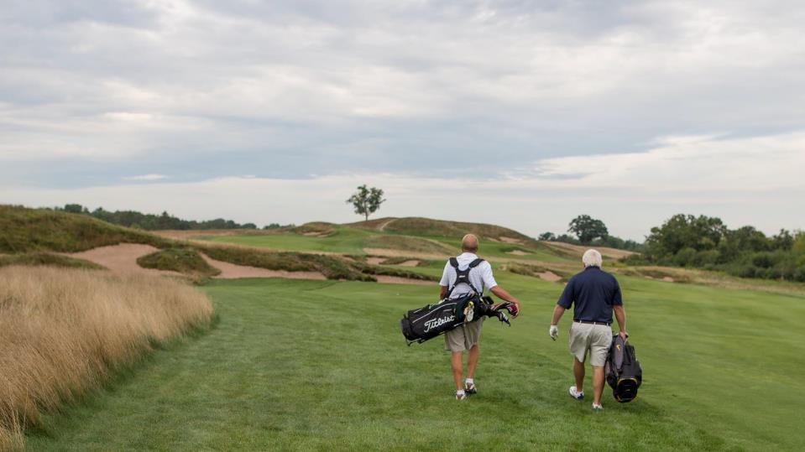
GOLF TOURNAMENTS
CORPORATE OUTING
Brown Deer Golf Course
7625 N Range Line Rd, Milwaukee WI 53209
DELEGATE OUTING
The Bog
3121 County Rd I, Saukville, WI 53080
Friday August 22, 2025

Slide 14
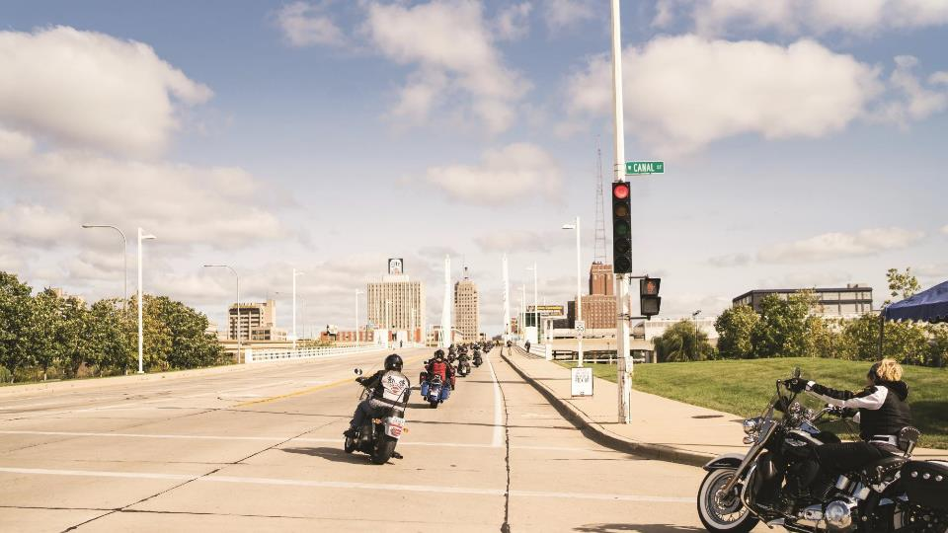
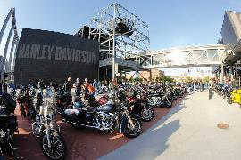
HARLEY-DAVIDSON RIDE
Friday August 22, 2025

Slide 15
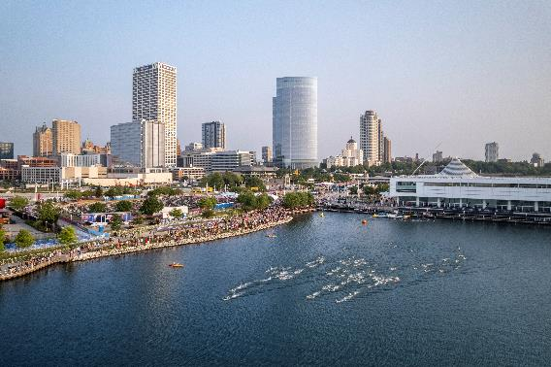
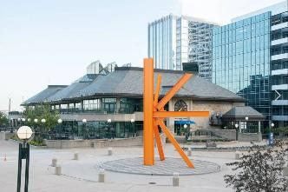
TAG RECEPTION
Zilli Lake & Garden
931 E. Wisconsin Avenue Milwaukee, WI 53202
Friday August 22, 2025

Slide 16
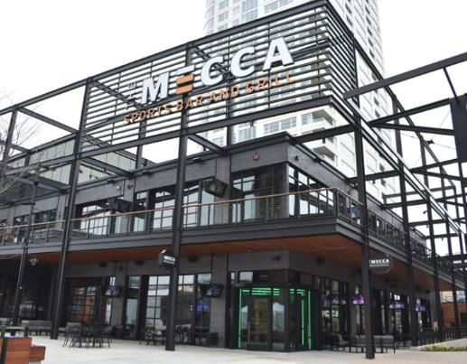
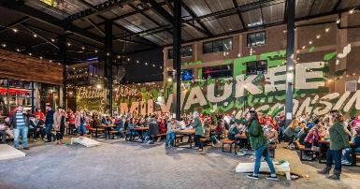
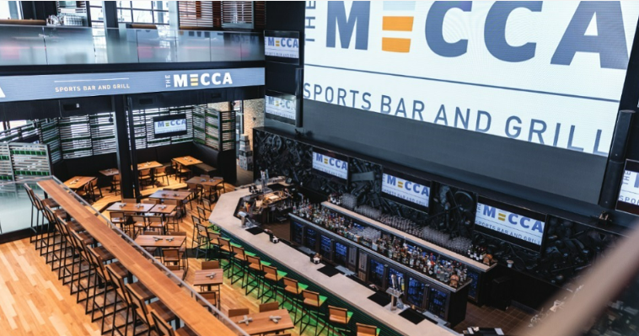
COMPANY GRADE / WARRANT OFFICER MIXER
MECCA and Beer Garden ~ Deer District
Friday August 22, 2025

Slide 17
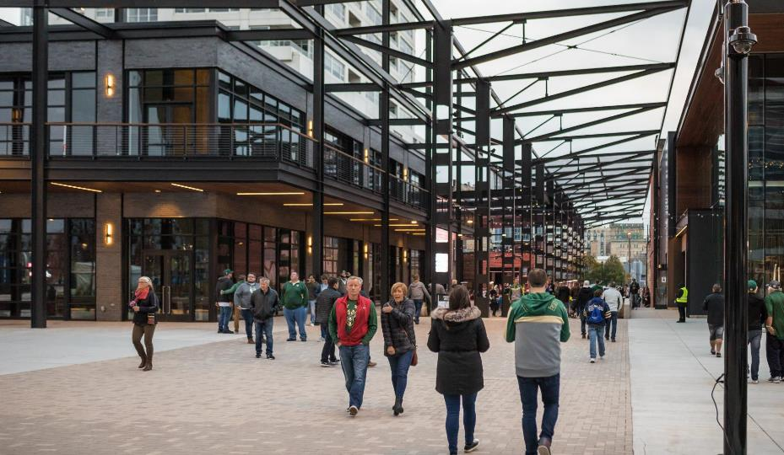
SENIOR WARRANT OFFICER MIXER
Gather ~ Deer District
Friday August 22, 2025

Slide 18
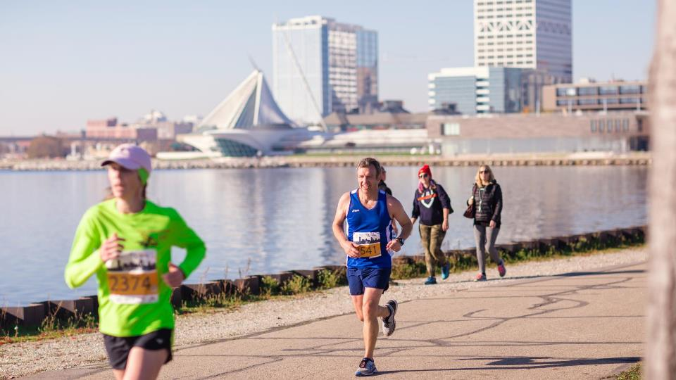
FUN RUN
Veterans Park
1010 N. Lincoln Memorial Dr Milwaukee, WI 53202
Saturday, August 23, 2025

Slide 19
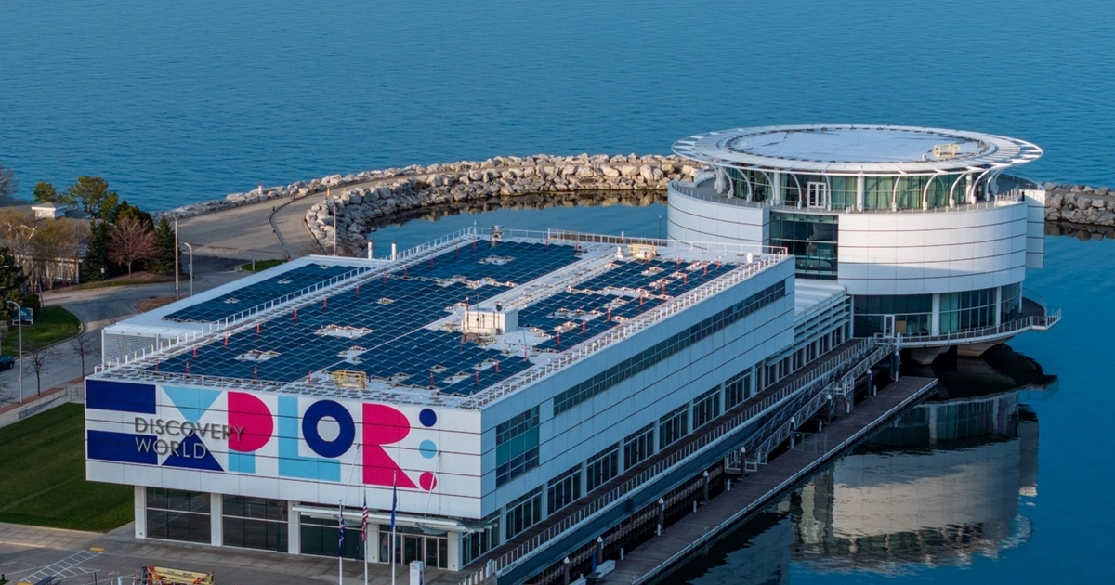
GOVERNOR’S RECEPTION
Discovery World
500 N. Harbor Dr Milwaukee, WI 53202
Saturday, August 23, 2025

Slide 20
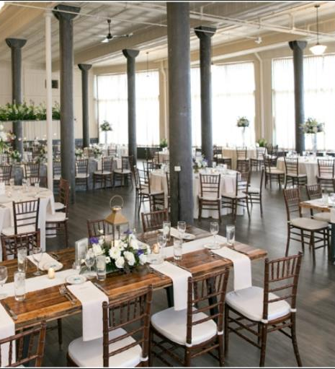
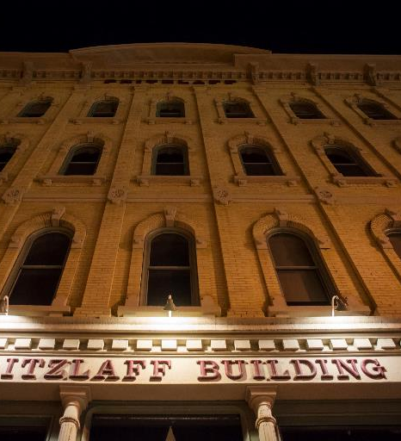
SPOUSES LUNCHEON
Pritzlaff Building
Third Ward Historic District
143 W St Paul Ave Milwaukee, WI 53203
Sunday, August 24, 2025

Slide 21
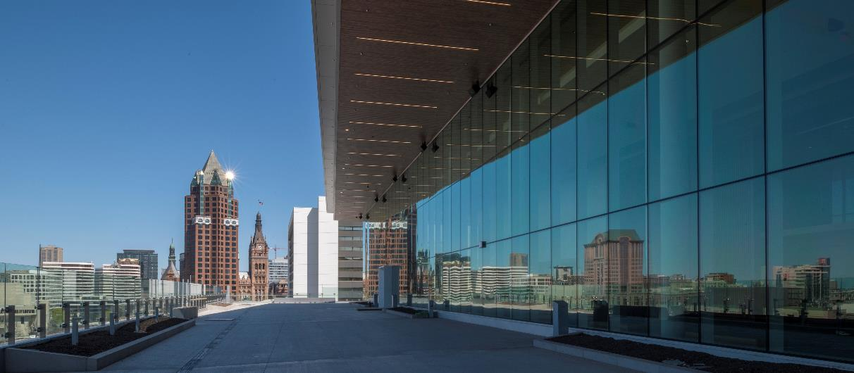
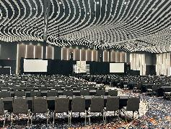
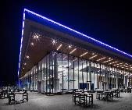
ALL STATES DINNER
Baird Ballroom ~ Baird Center
With comedian Charlie Berens
Monday, August 25, 2025

Slide 22
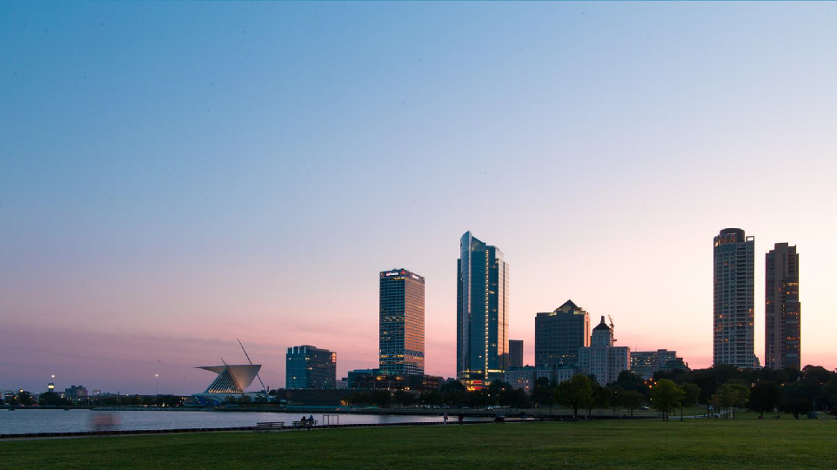
WE LOOK FORWARD TO HOSTING
IN 2025!

