Slide 1

NGAUS Awards Process Timeline
October – Call to States for nominations
15 Feb. – Nominations due to NGAUS
March - Awards Committee Meeting (Teleconference)
21 March – NGAUS Board of Directors Meeting
By 1 April – Notify states once list is approved by NGAUS board
August – Presentations at NGAUS conference

Slide 2
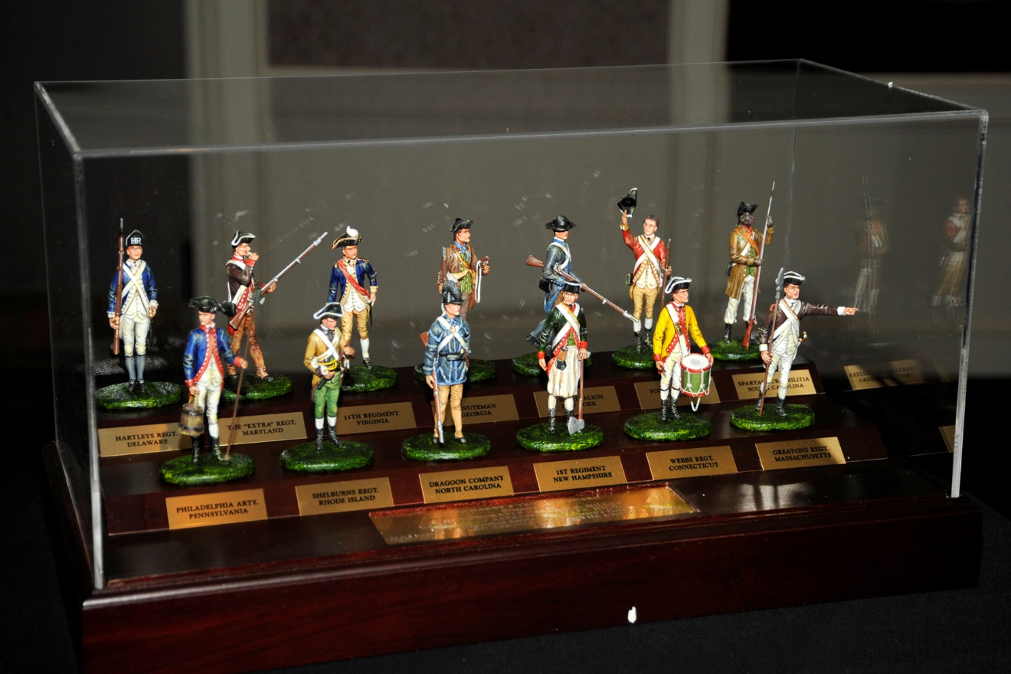
NGAUS Awards
Harry S. Truman Award
Highest NGAUS Award (first presented in 1969) Top Elected Officials/Military Officers

Slide 3
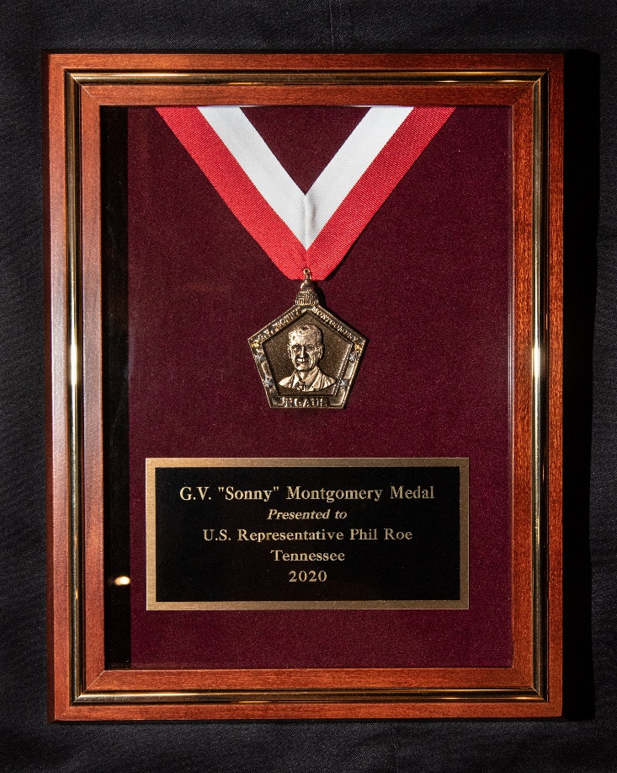
NGAUS Awards
G.V. “Sonny” Montgomery Medal
Second-highest award (first presented 2004) Top Elected Officials/Military Officers

Slide 4

NGAUS Awards
Charles Dick Medal of Merit
(First presented in 1989) Elected officials (national & state)

Slide 5
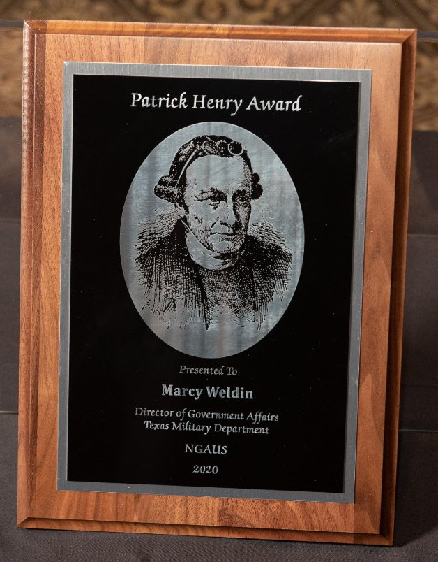
NGAUS Awards
Patrick Henry Award
(First presented in 1989) Elected officials (state & local) Staffers & other civic leaders

Slide 6
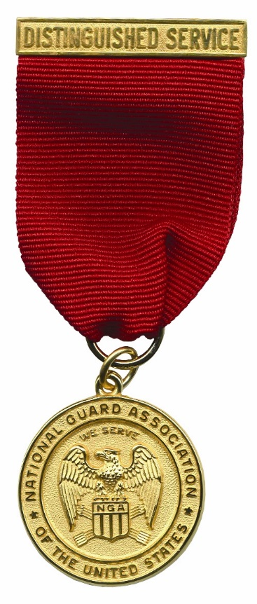
NGAUS Awards
Distinguished Service Medal
Oldest award (1950) Outstanding service by a Guardsman or Guard civilian

Slide 7

NGAUS Awards
Meritorious Service Award (1972)
Any member of the National Guard, NGAUS or the Armed Forces of the United States, or any civilian assigned to a NGB or state HQ Meritorious Service Certificate

Slide 8
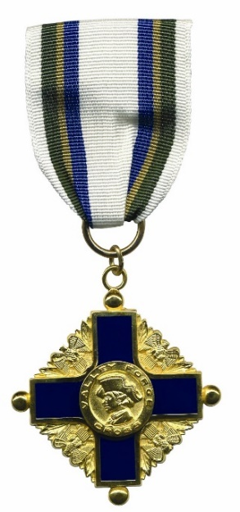
NGAUS Awards
Valley Forge Cross for Heroism (1973)
Performing acts of heroism and lifesaving acts
Valley Forge Certificate
Non-life threatening

Slide 9
NGAUS Awards
Garde Nationale Trophy (1989)
Significant achievement in civilian endeavors
Theodore Roosevelt Leadership Award for Company Grade Officers (2006)
State, territory or D.C. may submit no more than one ANG and one ARNG nomination each year
Eagle Rising Award for Warrant Officers (2011)
Nominees must be WO1-CW3 State, territory or D.C. may submit no more than one nomination each year

Slide 10

More Resources
www.ngaus.org/awards
Nomination Form
Criteria
Eligibility
Nomination and Selection Procedures

Slide 11
Questions?
NGAUS Staff POC: Rich Arnold
richard.arnold@ngaus.org awards@ngaus.org

